Slide 1
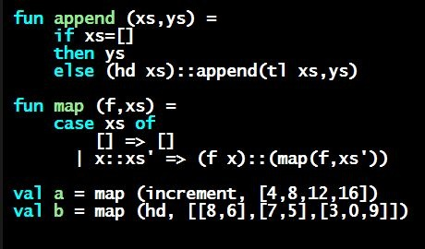
Programming Languages Dan Grossman University of Washington
Recommended Background

Slide 2
Assumed background
Not an introductory programming course
Assume you have at least 1-2 programming courses
Not an advanced course on programming languages
Won’t assume you are an experienced programmer
Somewhere in the middle…

Slide 3
Things I assume you know (a little)
Variables, conditionals (if), loops, arrays
Recursion (okay if lack a little confidence for now)
Implementation vs. interface (abstraction, modularity)
Possibly/probably using object-oriented programming
Basic data structures: linked lists, binary trees
Dynamic-dispatch
Also known as method overriding, subclassing, …
But not needed for first 2/3 of course and then will review

Slide 4
Any particular language
Fine if you mostly know Python or Javascript or…
What matters are the concepts on the previous slide
Occasionally compare to Java in optional videos (not on homework)
If know C#, can probably follow along
Will more rarely compare to C in optional videos (not on homework)
Can be very useful if you understand some C (or learn C later)
Really will “start programming over from the beginning”
Moving way too fast unless you have programmed some before

Slide 5
An example
This course is derived from a university course with specific preceding courses
Here is something students “on campus” could do/follow
But not this fast (I’m the teacher and I’m “cheating”)
And it’s fine if you’re rusty or don’t know Java or…
Not intended to intimidate you – all are welcome
Trying to show how I “live code” throughout the course
But here with less explanation!
Showing what I mean by “programming experience”

